Slide 1
Module 2, Part 2 The OSSTMM for Managers
Presented by Heorot.net

Slide 2
Objectives
Understand managerial tasks and responsibilities within the OSSTMM
Identify legal requirements and how the OSSTMM meets these requirements
Create Rules of Engagement
Become familiar with terminology
Understand what is “good security practices”
Create metrics

Slide 3
OSSTMM - Structure
For Managers and Project Managers
Document Scope
Compliance
Rules of Engagement
Process
Security Map
Risk Assessment
Security Metrics

Slide 4
OSSTMM – Document Scope
Primary purpose:
“…to provide a scientific methodology for the accurate characterization of security through examination and correlation in a consistent and reliable way.”
Secondary purpose:
“provide guidelines which when followed will allow the auditor to perform a certified OSSTMM audit”

Slide 5
OSSTMM – Document Scope
Requirements for Accreditation
Signed by the tester/analyst
Meet the reporting requirements
Anonymized report
What was tested
What was not tested

Slide 6
OSSTMM – Document Scope
Professional Certifications
OPST - OSSTMM Professional Security Tester
http://www.opst.org
OPSA - OSSTMM Professional Security Analyst
http://www.opsa.org
OPSE - OSSTMM Professional Security Expert
http://www.opse.org
OWSE - OSSTMM Wireless Security Expert
http://www.owse.org

Slide 7
OSSTMM – Document Scope
Terminology – Security Test Types
Blind
Double Blind (Black Box)
Grey Box
Double Grey Box (White Box)
Tandem
Reversal

Slide 8
OSSTMM – Process
Terminology –Error Types
Well-known terms
False Positive
False Negative
Human Error
Falsification
Sampling Error
Constraint
Other Terms
Grey Positive
Grey Negative
Specter
Indiscretion
Entropy Error
Propagation

Slide 9
OSSTMM – Compliance
Legal Compliance
U.S. Gramm-Leach-Bliley Act (GLBA)
U.S. Sarbanes-Oxley Act (SOX)
Health Insurance Portability and Accountability Act of 1996 (HIPAA)
Others listed:
California Individual Privacy Senate Bill - SB1386
USA Government Information Security Reform Act of 2000 section 3534(a)(1)(A) OCR HIPAA Privacy TA 164.502E.001, Business Associates [45 CFR §§ 160.103, 164.502(e), 164.514(e)]
OCR HIPAA Privacy TA 164.514E.001, Health-Related Communications and Marketing [45 CFR §§
164.501, 164.514(e)]
OCR HIPAA Privacy TA 164.502B.001, Minimum Necessary [45 CFR §§ 164.502(b), 164.514(d)]
OCR HIPAA Privacy TA 164.501.002, Payment [45 CFR 164.501]

Slide 10
OSSTMM – Rules of Engagement
Rules of Engagement (see page 19, OSSTMM)
Do’s and Don'ts
Sales & Marketing
Assessment / Estimated Delivery
Contracts and Negotiations
*Scope Definition
*Test Plan
*Test Process
*Reporting
*Required for successful completion of the PTE

Slide 11
OSSTMM – Rules of Engagement
Rules of Engagement (see page 19, OSSTMM)
Do’s and Don'ts
Sales & Marketing
Assessment / Estimated Delivery
Contracts and Negotiations
*Scope Definition
*Test Plan
*Test Process
*Reporting
*Required for successful completion of the PTE

Slide 12
OSSTMM – Rules of Engagement
Rules of Engagement
Scope Definition
Test Plan
Test Process
Reporting
Risk Assessment
Security Metrics
Each topic is covered in separate video presentations.

Slide 13
OSSTMM – Risk Assessment
What needs to be protected:
People
Culture information
Processes
Business
Image
Intellectual property
Legal rights
Intellectual capital

Slide 14
OSSTMM – Risk Assessment
Four Categories of Concern:
Safety
Privacy
Practicality
Usability
“Perfect Security”
Theoretical
Personal note: “Need to meet business objectives”

Slide 15
OSSTMM – Security Metrics
Three areas of concern:
Operations
Visibility, Trust, Access
Controls
Authentication, Indemnification, Subjugation, Continuity, Resistance, Non-repudiation, Confidentiality, Privacy, Integrity, Alarm
Limitations
Vulnerability, Weakness, Concern, Exposure, Anomaly

Slide 16
OSSTMM – Security Metrics
Count the values within each area
Operations = number of targets
Controls = number of instances
Limitations = number of flaws
Create a delta for each
In this case, a percentage for each
Obtain the “Actual Delta”
∆Op + ∆Con - ∆Lim = ∆Actual
Combine Hashes of all three area to obtain the “Risk Assessment Value” (RAV)
http://www.isecom.org/research/ravs.shtml

Slide 17
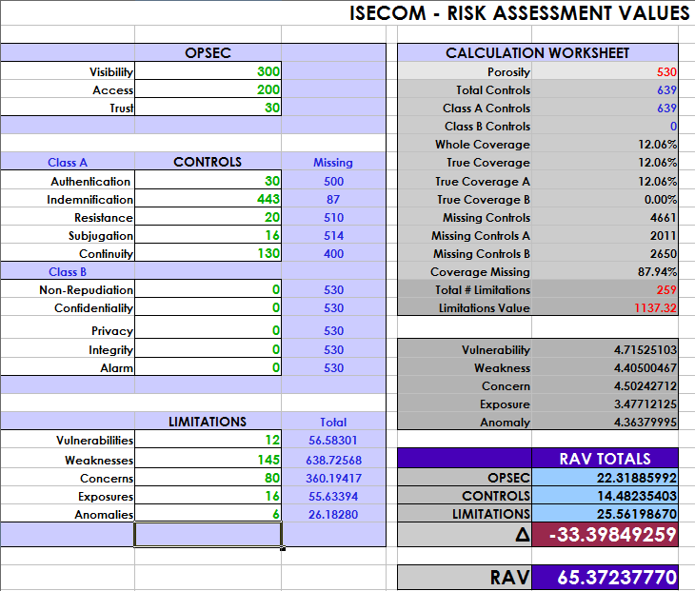
OSSTMM – Security Metrics

Slide 18
Conclusion – Module 2 Part 2
Understand managerial tasks and responsibilities within the OSSTMM
Identify legal requirements and how the OSSTMM meets these requirements
Understand Rules of Engagement
Become familiar with terminology
Identify what is “good security practices”
Security metrics

